Slide 1

NUS FinTech SG DevOps Assignment

Slide 2

Car Rental Service App
Service that connects tourists to rental vehicle companies with the push of a button. Matching between rented vehicle and tourist will be done automatically based on preference and availability.

Slide 3









Recommended Technology

Slide 4


Recommended Automation System
Automation of business tasks
Version Control & Project Management

Slide 5
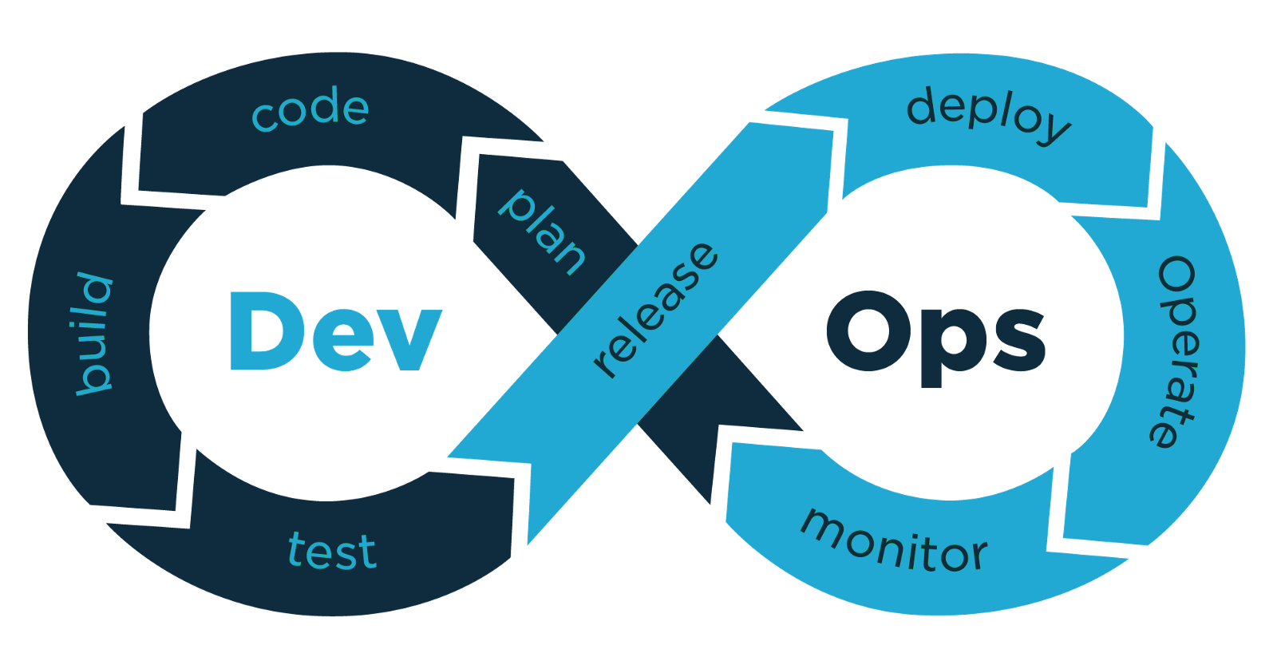
Development and Operations Methodology
Biz & Ops side
Developer side
Equal collaboration between Developer units and Business units

Slide 6
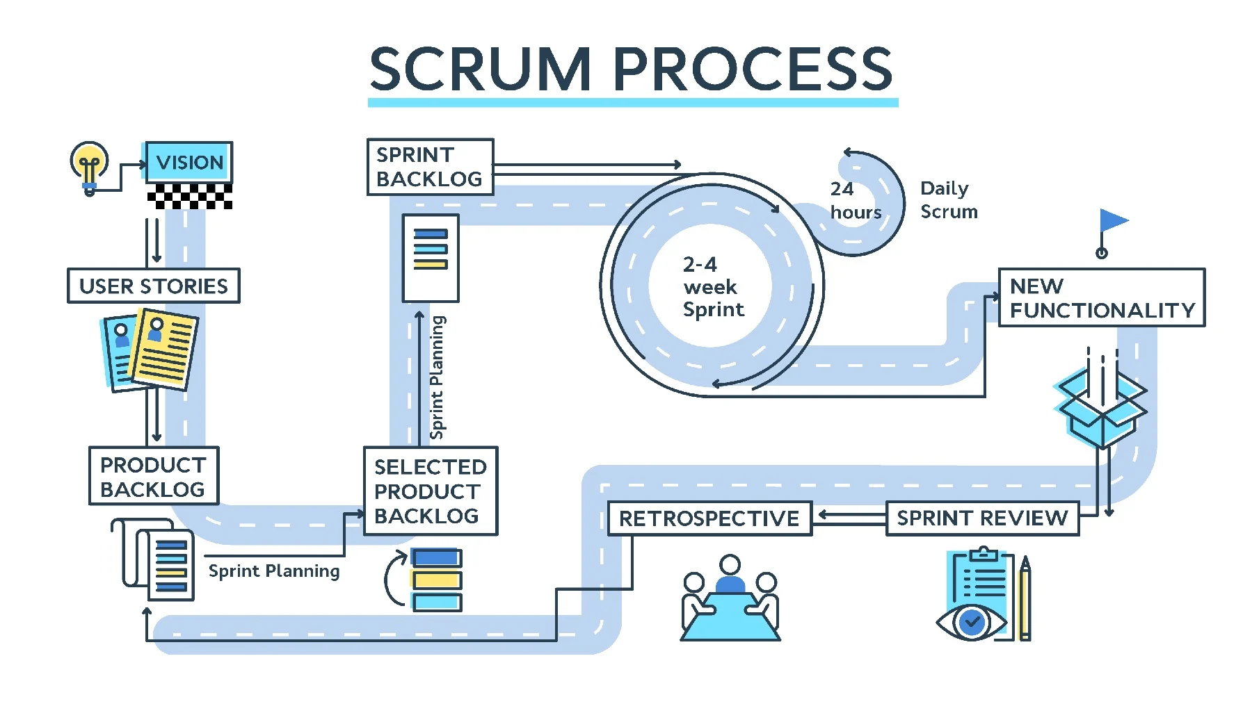

Recommended Team Structure: Dev Side
Flat Hierarchy: organization structure with few or no levels of management between management and staff level employees
Scrum: agile framework for developing, delivering, and sustaining complex products, with an initial emphasis on software development

Slide 7

Recommended Team Structure: Ops Side
Flat Hierarchy: organization structure with few or no levels of management between management and staff level employees
Project Management: process of leading the work of a team to achieve goals and meet success criteria at a specified time.

